Slide 1



Research Quality and the Hong Kong Principles
Professor Paul Glasziou
(with thanks to Lex Bouter & David Moher)

Slide 2

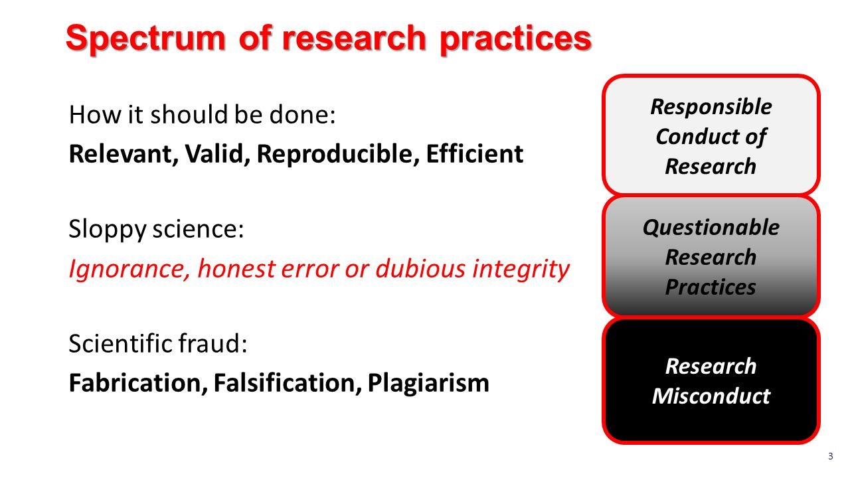
Outline
The problems of waste
Change & incentives
The Hong Kong Principles
Lex Bouter, VMC, Netherlands

Slide 3

Begley’s Bombshell
Between 2002-2012, Amgen able to reproduce the seminal findings from just 6 of 53 “top tier” publications.
- papers reporting something completely “new”
In the majority, data was not reproduced by the original investigators with their reagents in their lab
Amgen’s experience is not unique….
Begley and Ellis. Nature (2012) 483: 531

Slide 4
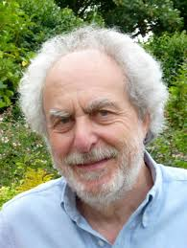
A very brief history of research waste
1994 - “huge sums of money are spent annually on research
that is seriously flawed through the use of inappropriate designs, unrepresentative samples, small samples, incorrect methods of analysis,
and faulty interpretation”
Doug Altman, The Scandal of Poor Medical Research, BMJ.
2009 – Chalmers & Glasziou, Lancet: ~85% research avoidably wasted; > $100B
2012 Begley & Ellis - reproduced key findings from only 6/53 “top tier” publications
2014 Lancet 5-part series: Adding Value, Avoiding Waste
2014 Ensuring Value in Research (EVIR) funders forum initiated
2018 NHMRC Research Quality Committee set up

Slide 5
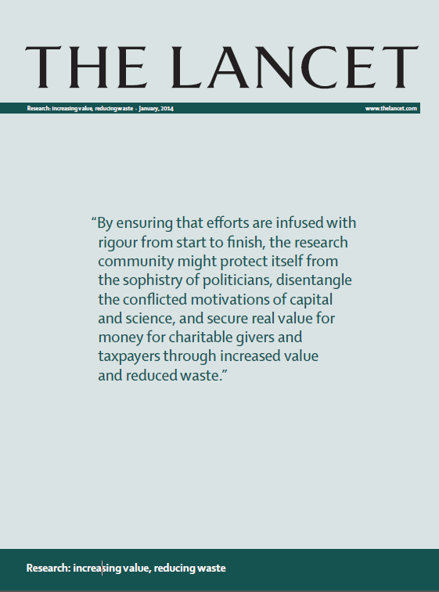
Annual avoidable waste in research
estimated to be 85% from:
avoidable design flaws (50%),
non-publication (50%) and
unusable reports (50%)
– for a global total of over $140 Billion/year.
Calculation at: http://blogs.bmj.com/bmj/2016/01/14/
paul-glasziou-and-iain-chalmers-is-85-of-health-research-really-wasted/
Adding Value, Reducing Waste;
Lancet Series 2014 (42 authors)
www.researchwaste.net
Questions relevant to users of research
Appropriate design, conduct & analysis
Efficient regulation and delivery
Accessible full research reports
Unbiased & usable reports
Notes:
Calc on 3 stages

Slide 6
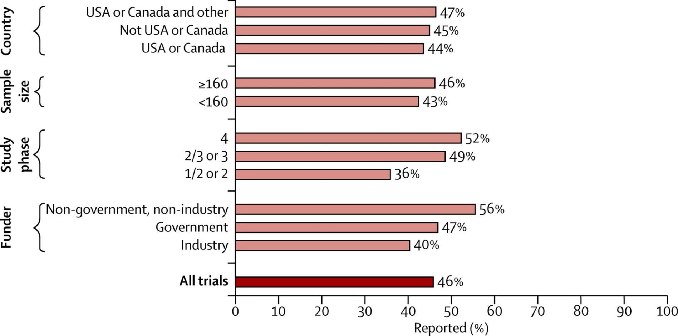

50% of research is not published
WASTE
Lancet 2014;383:257–66
Questions relevant to users of research
Appropriate design, conduct & analysis
Efficient regulation and delivery
Accessible full research reports
Unbiased & usable reports

Slide 7
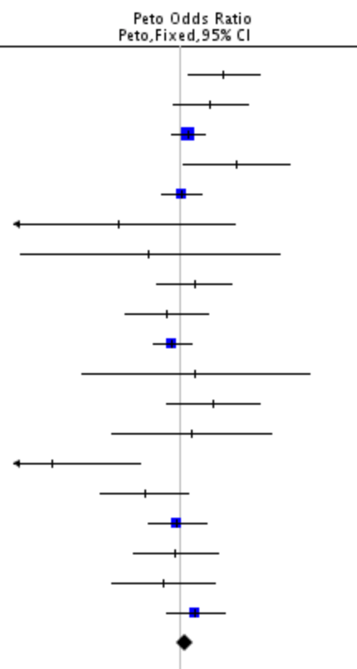
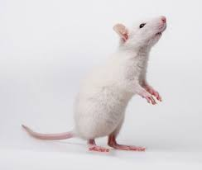
New research should build on previous research
Horn J et al. Very Early Nimodipine Use in Stroke (VENUS): a randomized, double-blind, placebo-controlled TRIAL. Stroke. 2001
RESULTS: At trial termination, (225 nimodipine, 229 placebo),
no effect of nimodipine was found.
Horn J, et al. Calcium antagonists for acute ischemic stroke.
The Cochrane Database of SYSTEMATIC REVIEWS. 2001.
RESULTS “28 trials were included (7,521 patients).
No effect on poor outcome (OR 1.07), or on death at end of follow-up (OR 1.10)”
Horn J et al. Nimodipine in ANIMAL model experiments of focal cerebral ischemia: a SYSTEMATIC REVIEW Stroke. 2001 Oct.
“20 studies … review did not show convincing evidence to substantiate the decision to perform trials with nimodipine in large numbers of patients.”
Questions relevant to users of research
Appropriate design, conduct & analysis
Efficient regulation and delivery
Accessible full research reports
Unbiased & usable reports

Slide 8

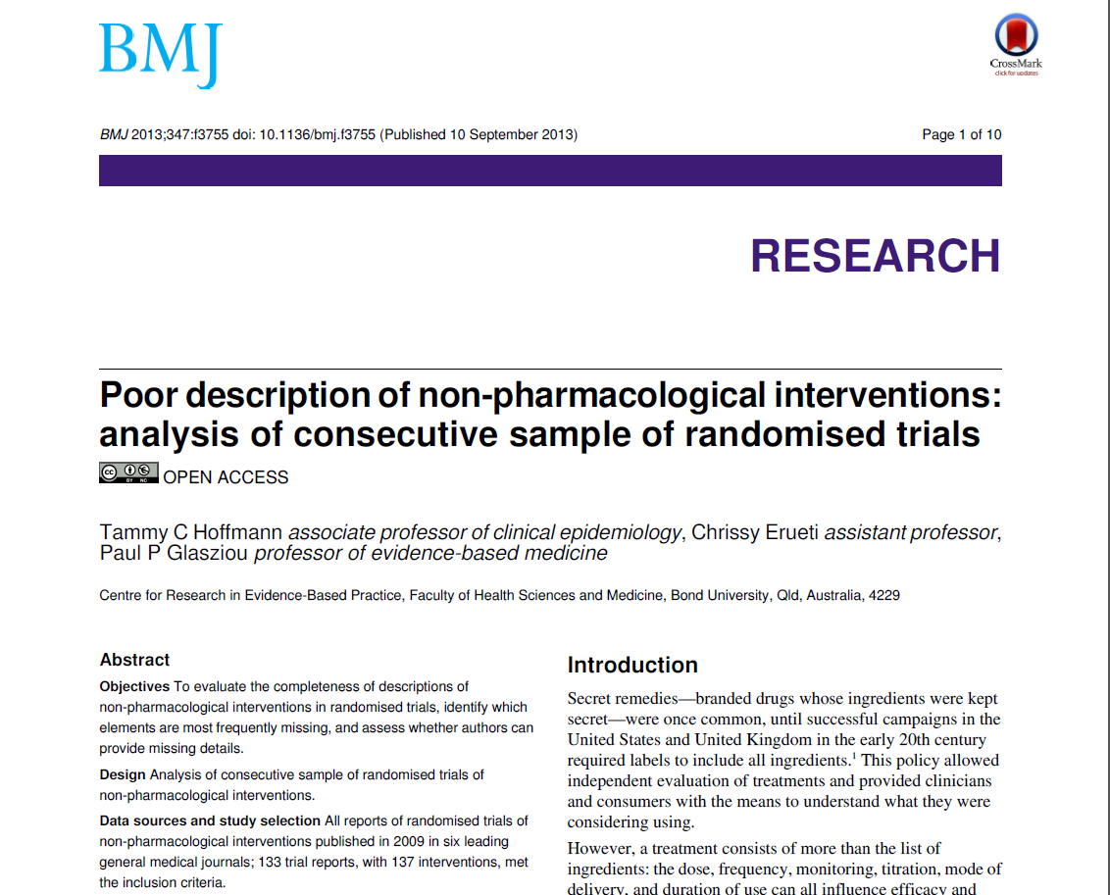
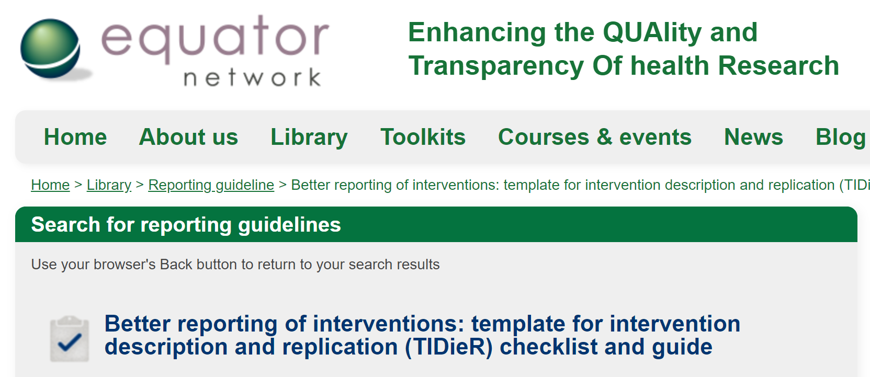
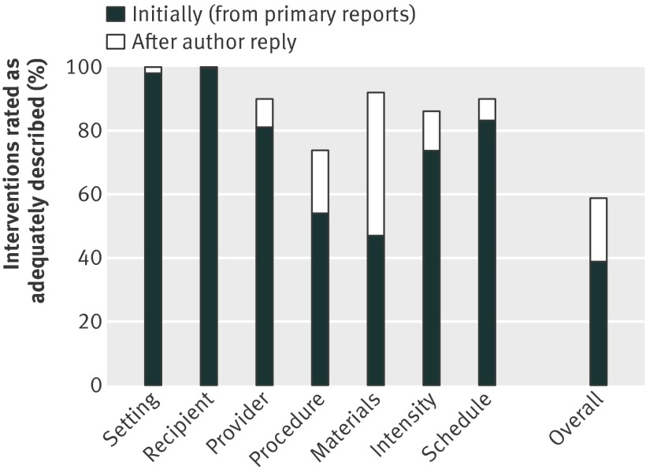
Improving reporting of research
61%
http://www.tidierguide.org/
Questions relevant to users of research
Appropriate design, conduct & analysis
Efficient regulation and delivery
Accessible full research reports
Unbiased & usable reports

Slide 9

“Waste” = Opportunity
Published unpublished studies!!
Reduce inefficiencies and overheads in research
3. (Rapid) reviews of previous research before new research
4. Education and training for good research practice
5. Infrastructure for research quality
Questions relevant to users of research
Appropriate design, conduct & analysis
Efficient regulation and delivery
Accessible full research reports
Unbiased & usable reports

Slide 10
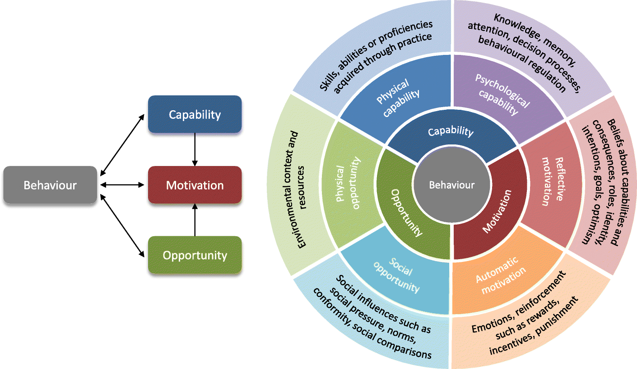
“COM-B” model
From: https://implementationscience.biomedcentral.com/articles/10.1186/s13012-018-0821-y/figures/1
Notes:
https://implementationscience.biomedcentral.com/articles/10.1186/s13012-018-0821-y/figures/1

Slide 11
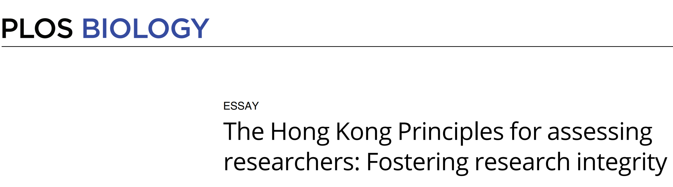


PLoS Biology 2020; 18: e3000737
Grants applications
Vacancies
Promotion
Tenure
Awards
Notes:
These are some of the forms assessment of individual researchers can take.

Slide 12
Hong Kong Principles
  Assess responsible research practices
  Value complete reporting
  Reward the practice of Open Science
  Acknowledge a broad range of research activities
  Recognize other tasks like peer review and mentoring
Notes:
Moher D, Bouter L, Kleinert S, Glasziou P, Sham MH, Barbour V, Coriat AM, Foeger N, Dirnagl U. The Hong Kong principles for assessing researchers: fostering research integrity. PLoS Biology 2020; 18: e3000737
https://journals.plos.org/plosbiology/article?id=10.1371/journal.pbio.3000737

Slide 13
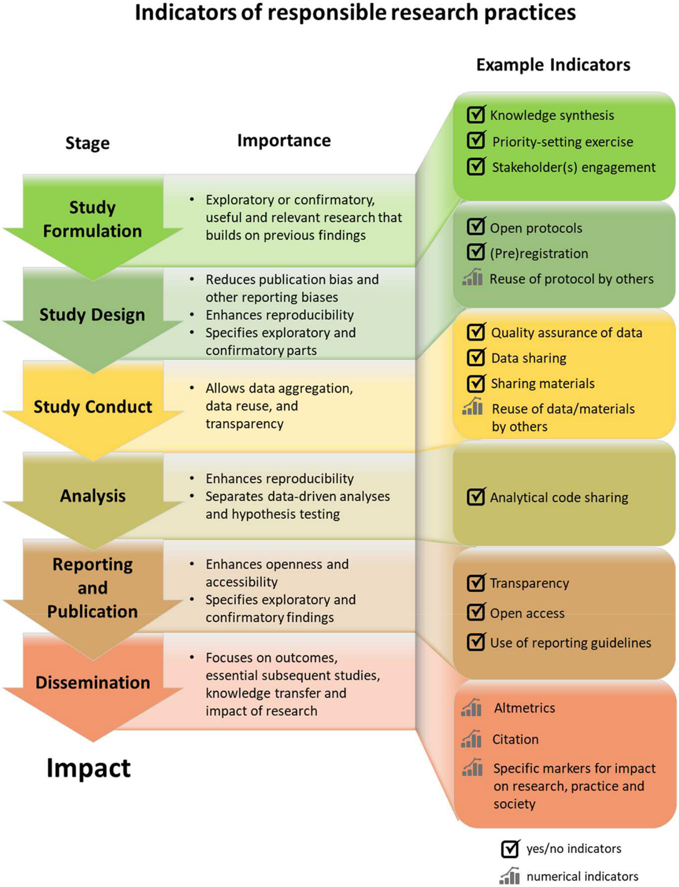
Principle 1: Assess researchers on responsible practices from conception to delivery, including the development of the research idea, research design, methodology, execution, and effective dissemination
Moher D, Bouter L, Kleinert S, Glasziou P, Sham MH, Barbour V, Coriat AM, Foeger N, Dirnagl U. The Hong Kong Principles for assessing researchers: Fostering research integrity. PLoS Biol. 2020 Jul 16;18(7):e3000737.
Notes:
We also developped some indicators of the responsible research practices that should be acknowledged in the assessment of researchers.
Moher D, Bouter L, Kleinert S, Glasziou P, Sham MH, Barbour V, Coriat AM, Foeger N, Dirnagl U. The Hong Kong principles for assessing researchers: fostering research integrity. PLoS Biology 2020; 18: e3000737
https://journals.plos.org/plosbiology/article?id=10.1371/journal.pbio.3000737

Slide 14
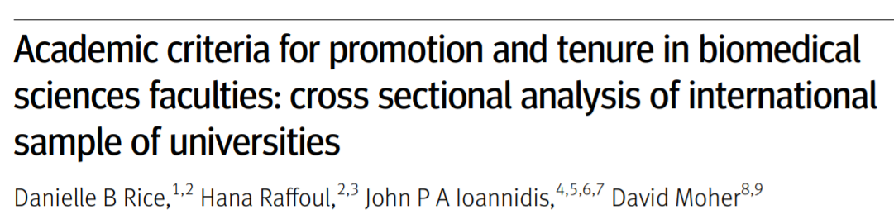
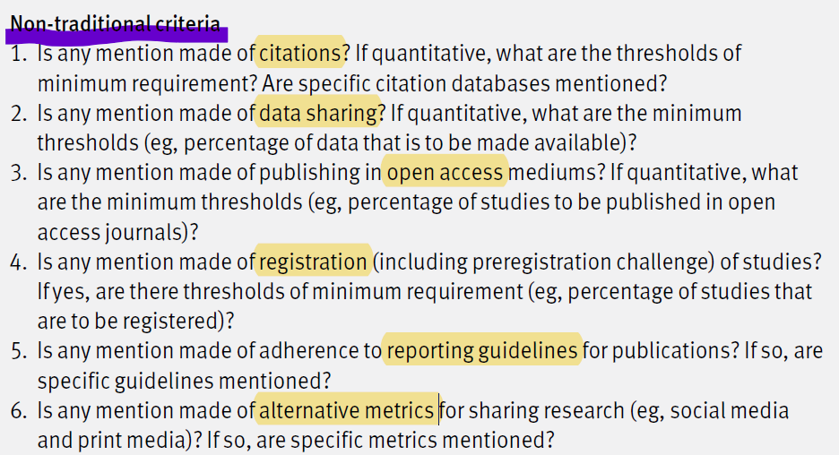
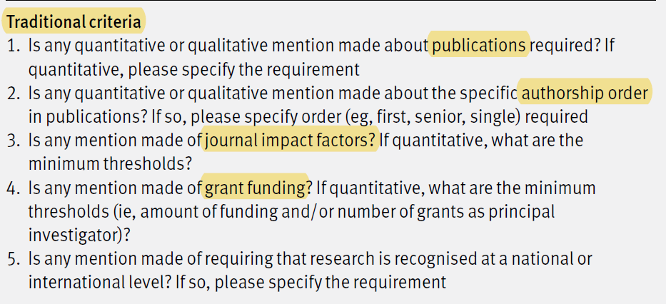
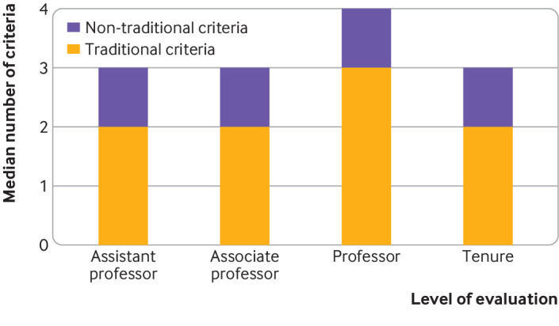
https://www.bmj.com/content/369/bmj.m2081.long

Slide 15
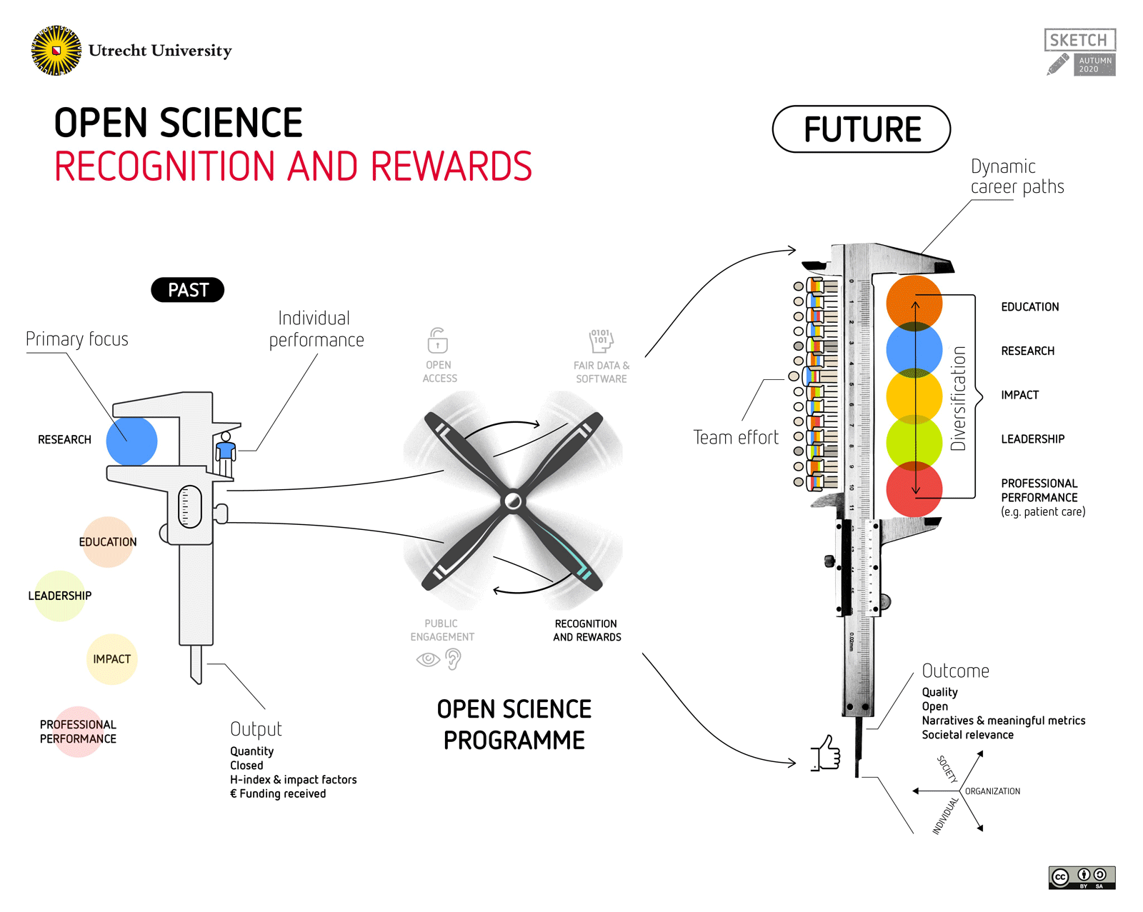
https://www.uu.nl/en/research/open-science

Slide 16




Infrastructure
eg
Study
Registration
Survey
The objectives of the Strategy are to:
support a research culture in NHMRC-funded institutions that is conducive to the conduct of high quality research
support high quality in the development, design, methodology, conduct and analysis of NHMRC-funded research
support transparency of NHMRC-funded research
support accountability for high quality research by NHMRC-funded institutions and their institutional review committees
ensure the need for incremental and breakthrough innovations is balanced with the need for necessary replication, and
ensure NHMRC’s processes are efficient while supporting high quality research.
Training
Institutional
Support
https://www.nhmrc.gov.au/research-policy/research-quality

Slide 17

http://aus-rn.org/

