Slide 1


Hong Kong Principles
for assessing researchers with a view to foster research integrity
Lex Bouter
Notes:
Pre-recorded video (5-7 minutes) for the 2020 Global Research Council Virtual Conference on Responsible Research Assessment.

Slide 2
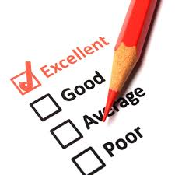
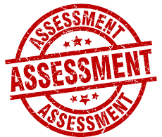
Grants applications
Vacancies
Promotion
Tenure
Awards
Notes:
These are some of the forms assessment of individual researchers can take.

Slide 3
core message
We should reward responsible research practices and avoid perverse incentives when assessing researchers and not merely rely on bibliometric indicators.
Notes:
Bibliometric indicators are publication and citation counts and their derivatives like Impact Factor and Hirsch Index.

Slide 4
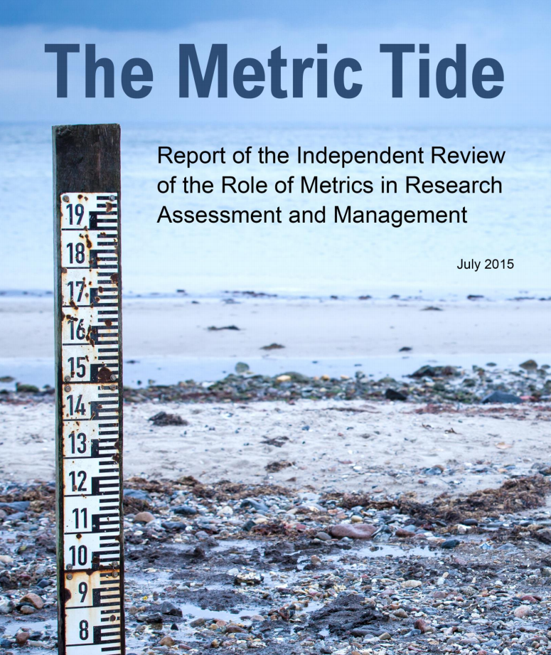
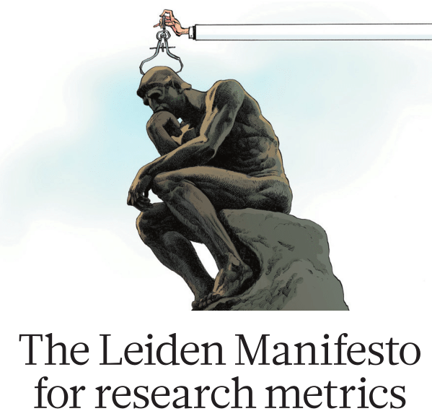

Notes:
During recent years the simplistic and isolated use of quantitative bibliometric indicators (e.g. Impact Factor and H-index) to evaluate research institutes and research programs has been strongly criticized.
My point today is that they can be strong perverse incentives when dominating the assessment of individual researchers.
That leads to moral dilemmas researchers have to face and navigate.
https://re.ukri.org/sector-guidance/publications/metric-tide/
http://www.leidenmanifesto.org/
https://sfdora.org/read/

Slide 5
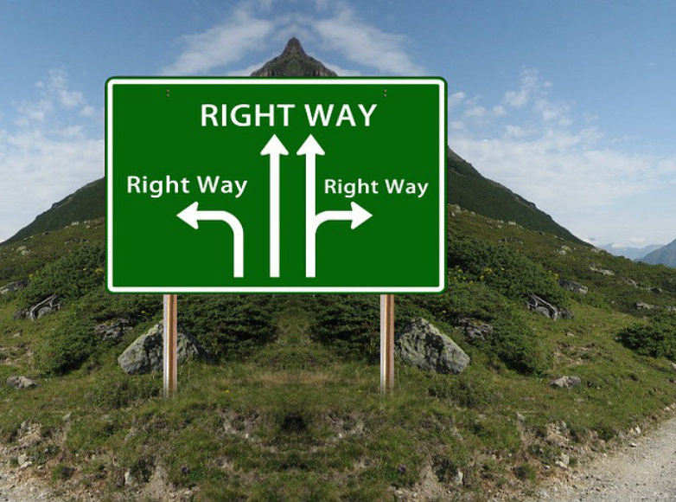
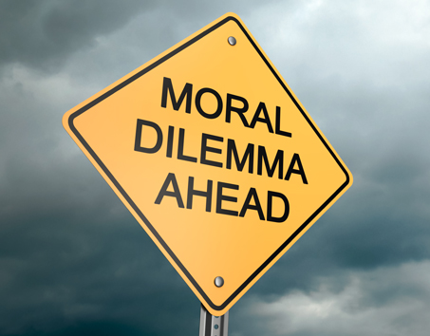
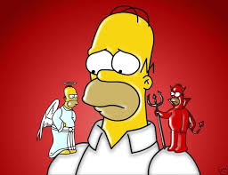
What is good for the truth of and the trust in research is not always good for your academic career
Notes:
Consequently overuse of bibliometric indicators can also be a strong perverse incentive at the level of the individual researcher.
Many rewards in academia are linked to having positive and spectacular results as these are published more easily in high impact journals and will be cited more often.
The various Questionable Research Practices have in common that they can effectively help to get these positive and spectacular results.

Slide 6
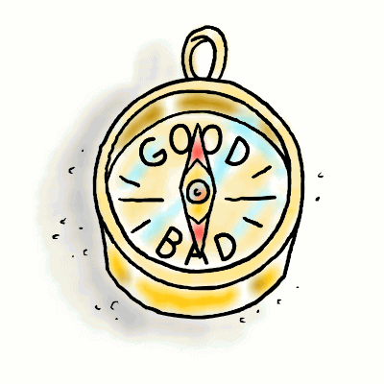
Functioning of moral compass depends on
Virtuousness of the individual
Research climate in the lab
Adequate incentives
Notes:
Researchers navigate the dilemmas in their work with their moral compass.
But there are also strong other drivers of their behaviour in the direct professional environment and the system of science at large.
That doesn’t deminish the personal responsibility to behave well in research.
In fact it makes personal responsilility larger: individual researchers also have to help to improve the research climate and to remove perverse incentives.

Slide 7
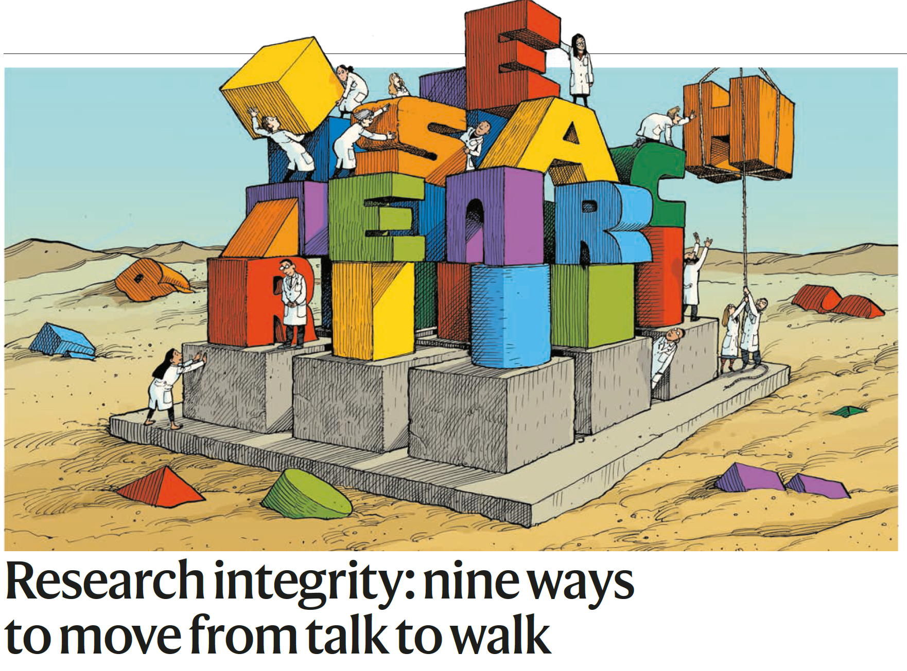

Nature 2020; 586: 358-60
Notes:
Researchers need help from their institutions in avoiding questionable research practices.
Recently we published in Nature what these institutions should do specifically, based on research from a large EU consortium.
Mejlgaard N, Bouter LM, Gaskell G, Kavouras P, Allum N, Bendtsen AK, Charitidis CA, Claesen N, Dierickx K, Domaradzka A, Reyes Elizondo A, Foeger N, Hiney M, Kaltenbrunner W, Labib K, Marušić A, Sørensen MP, Ravn T, Rea Ščepanović R, Tijdink JK, Veltri GA. Research integrity: nine ways to move from talk to walk. Nature 2020; 586: 358-60. (https://www.nature.com/articles/d41586-020-02847-8)

Slide 8
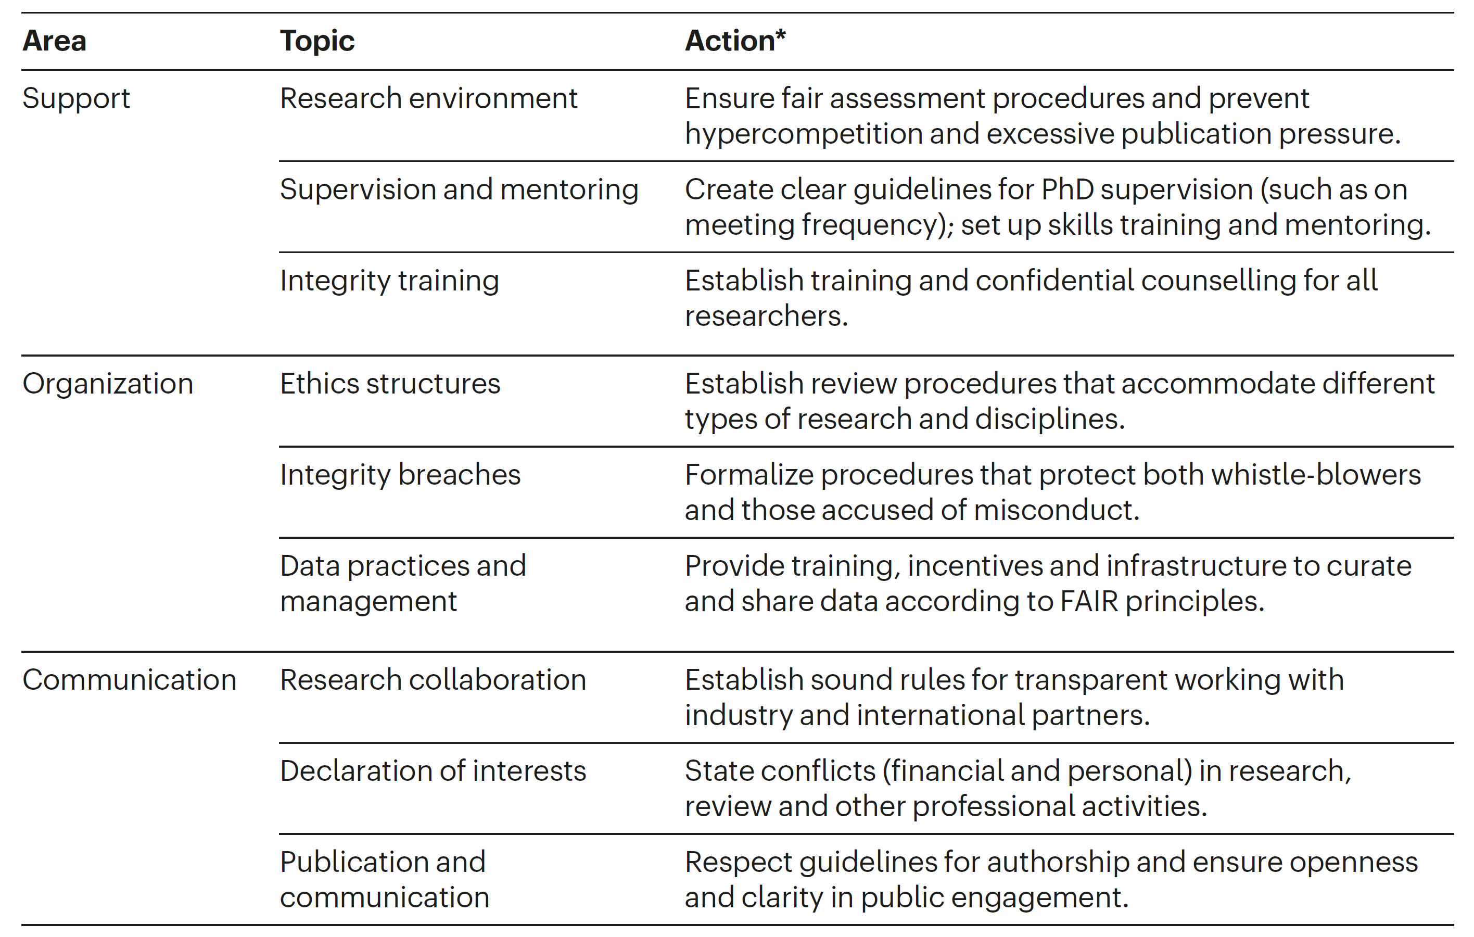
Notes:
This is the summary table of our findings.
I have no time to present them all.
But I’ll focus on one example for inproving the research environment: ensure fair assessment procedures, because these procedures cover many of the other 8 topics.
Mejlgaard N, Bouter LM, Gaskell G, Kavouras P, Allum N, Bendtsen AK, Charitidis CA, Claesen N, Dierickx K, Domaradzka A, Reyes Elizondo A, Foeger N, Hiney M, Kaltenbrunner W, Labib K, Marušić A, Sørensen MP, Ravn T, Rea Ščepanović R, Tijdink JK, Veltri GA. Research integrity: nine ways to move from talk to walk. Nature 2020; 586: 358-60. (https://www.nature.com/articles/d41586-020-02847-8)

Slide 9
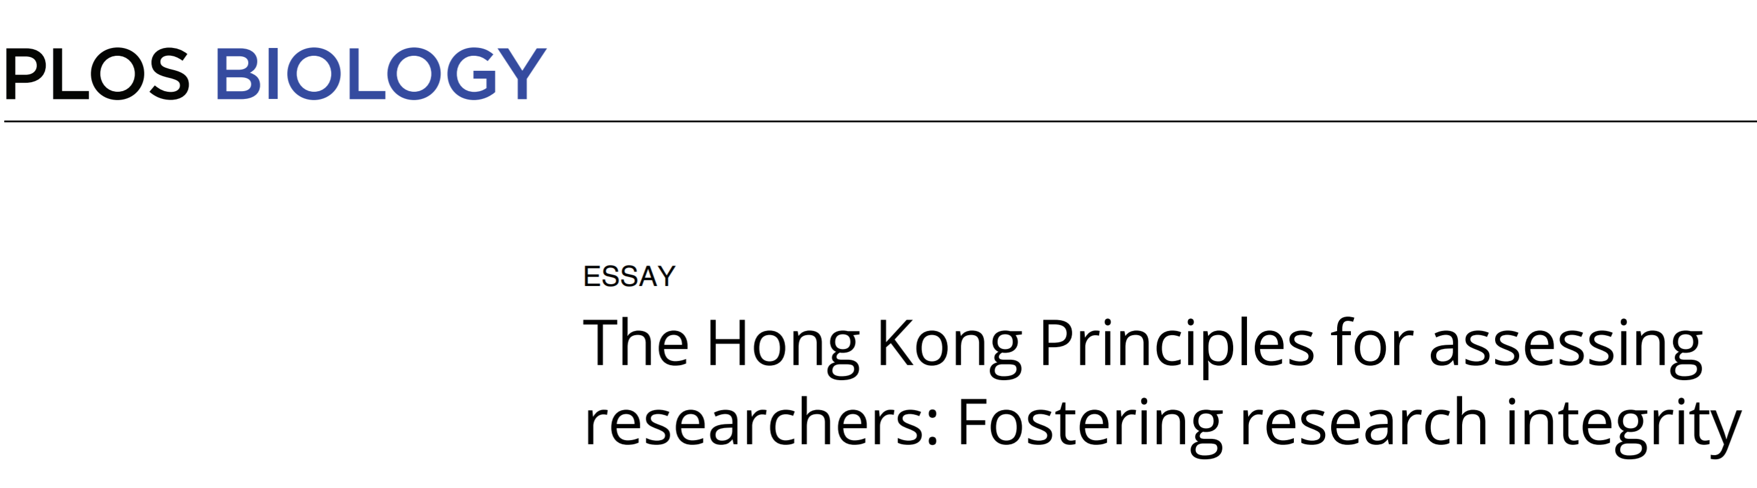
PLoS Biology 2020; 18: e3000737
Notes:
How to realize fair assessment procedures of researchers is outlined in the HKPs.
The name Hong Kong refers to the city where the 6th WCRI was held in 2019. Before and during the conference we discussed the HKPs and after the conference they were endorsed by its participants.
Moher D, Bouter L, Kleinert S, Glasziou P, Sham MH, Barbour V, Coriat AM, Foeger N, Dirnagl U. The Hong Kong principles for assessing researchers: fostering research integrity. PLoS Biology 2020; 18: e3000737
https://journals.plos.org/plosbiology/article?id=10.1371/journal.pbio.3000737

Slide 10
Hong Kong Principles
  Assess responsible research practices
  Value complete reporting
  Reward the practice of Open Science
  Acknowledge a broad range of research activities
  Recognize other tasks like peer review and mentoring
Notes:
Moher D, Bouter L, Kleinert S, Glasziou P, Sham MH, Barbour V, Coriat AM, Foeger N, Dirnagl U. The Hong Kong principles for assessing researchers: fostering research integrity. PLoS Biology 2020; 18: e3000737
https://journals.plos.org/plosbiology/article?id=10.1371/journal.pbio.3000737

Slide 11
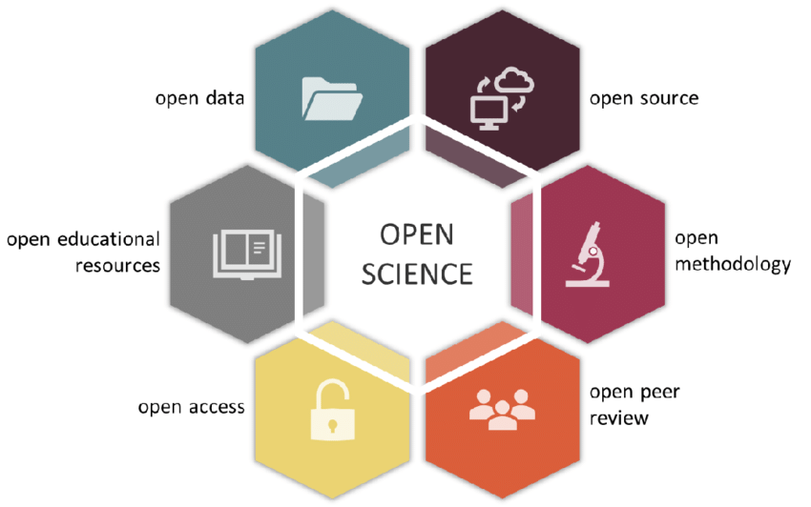


Notes:
Open science practices can help in fostering research integrity by making research more transparant, reproducible and controllable.
They take time and effert and need to be recognized in assessment procedures which is what the HKPs aim for.
FAIR = Findable, Accessible, Interoperable and Reusable
Nosek BA, Ebersole CR, DeHaven AC, Mellor D. The preregistration revolution. PNAS 2018;115:2600-6. (http://www.pnas.org/content/115/11/2600)
Rice and Moher - Curtailing the use of preregistration - a misused term - Perspectives on Psychological Science 2019; 14 1105-8.
NAS - Open Science by design - realizing a vision for 21th century research - Washington, 2018 (https://www.nap.edu/download/25116)
https://www.fosteropenscience.eu/
https://cos.io/
https://cos.io/rr/
https://www.go-fair.org/fair-principles/

Slide 12
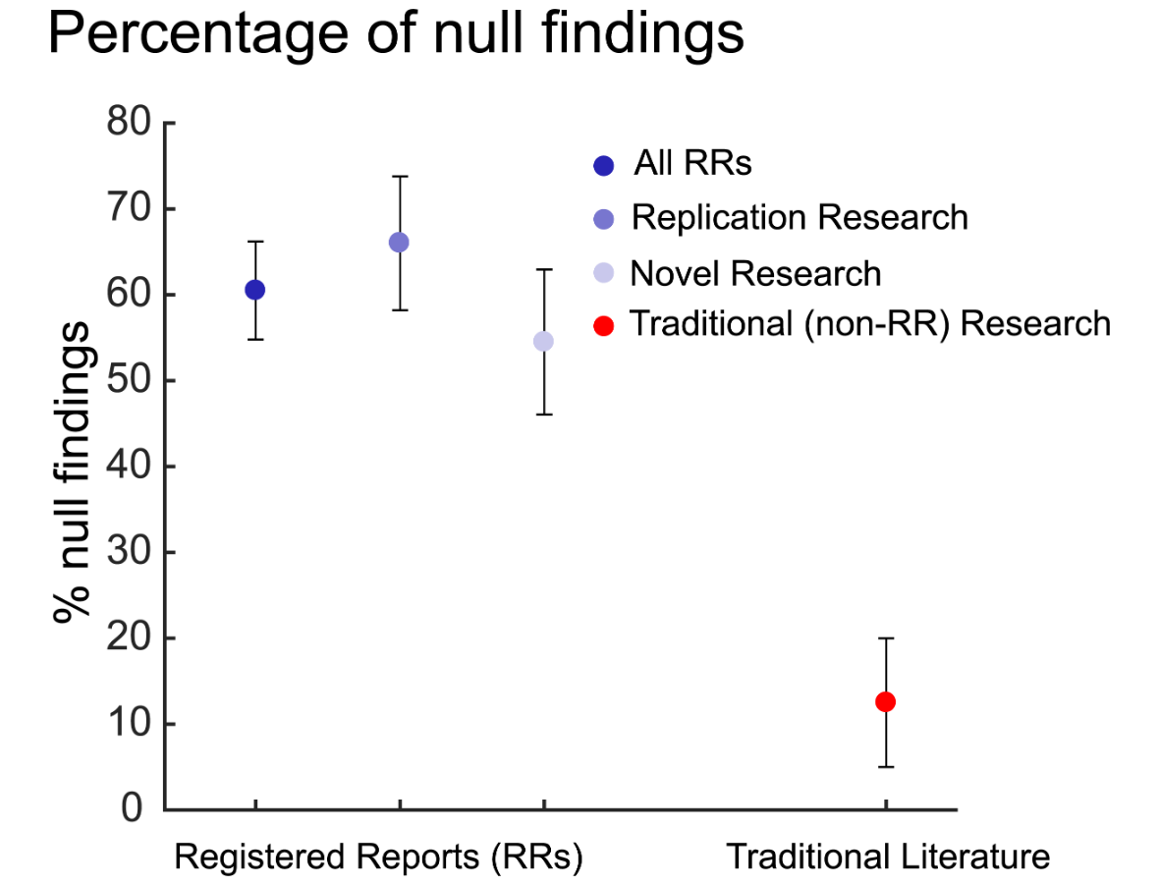
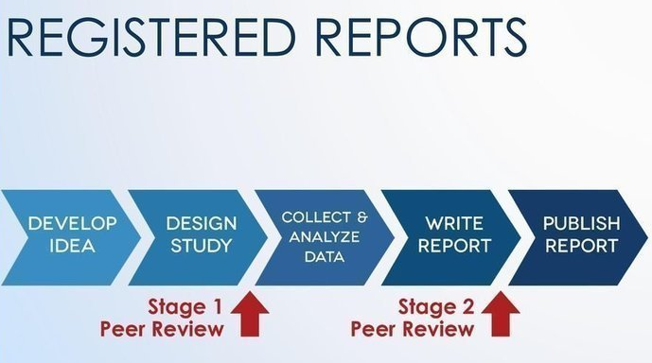
used by 265 journals
Notes:
An example of a responsible research practice the HKPs want being recognized is engaging in pre-registration of study protocols or – even better – submitting them as registered report.
Chambers C. What's next for registered reports. Nature 2019; 573 187-189
Allen C, Mehler DMA. Open science challenges, benefits and tips in early career and beyond. PLoS Biol 2019; 17(5): e3000246. https://doi.org/10.1371/journal.pbio.3000246
https://cos.io/rr/

Slide 13
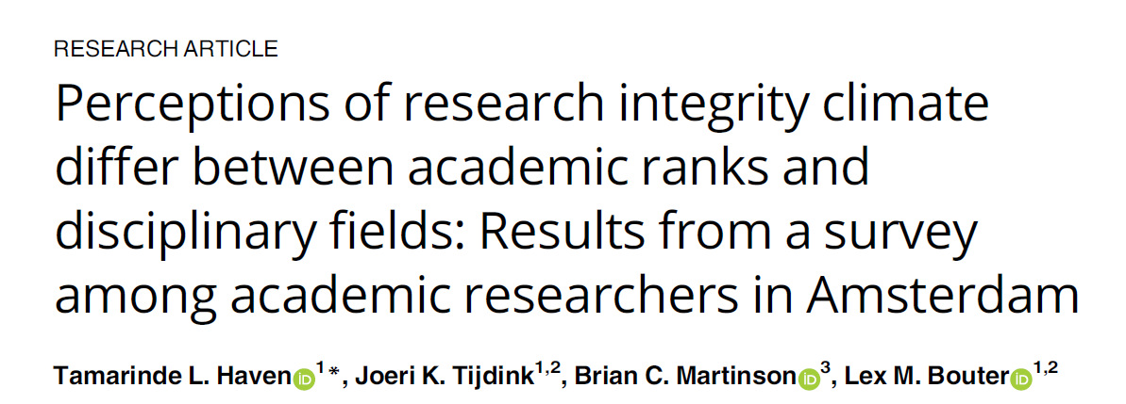

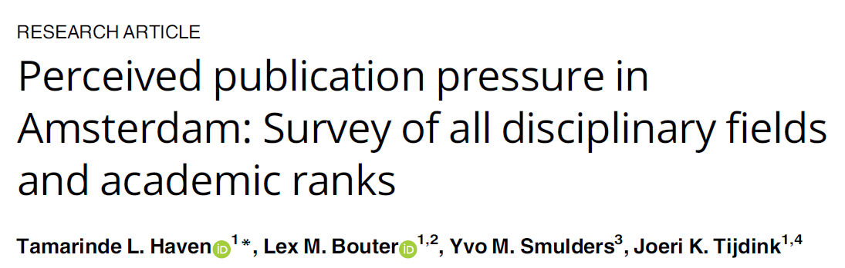
PLoS One 2019; 14: e0210599
PLoS One 2019; 14: e0217931
Notes:
Recent research indicated strongly that researchers want to be rewarded (and not punished) for engaging in behaviour that improves the quality of their work.
The Wellcome Trust recently published very informative survey results on how researchers perceive their culture: (https://wellcome.ac.uk/sites/default/files/what-researchers-think-about-the-culture-they-work-in.pdf).
The Academic Research Climate in Amsterdam (ARCA) study) explored these perceptions empirically.
Haven TL, Tijdink JK, Martinson BC, Bouter LM. Perceptions of research integrity climate differ between academic ranks and disciplinary fields: results from a survey among academic researchers in Amsterdam. PLoS One 2019; 14: e0210599 (https://doi.org/10.1371/journal.pone.0210599).
Haven TL, Bouter LM, Smulders YM, Tijdink JK. Perceived publication pressure in Amsterdam: survey of all disciplinary fields and academic ranks. PLoS One 2019; 14: e0217931. (https://doi.org/10.1371/journal.pone.0217931)
See also: http://www.amsterdamresearchclimate.nl/

Slide 14
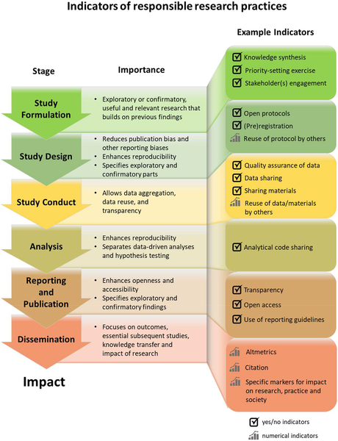
Moher D, Bouter L, Kleinert S, Glasziou P, Sham MH, Barbour V, Coriat AM, Foeger N, Dirnagl U
The Hong Kong Principles for assessing researchers: fostering research integrity
PLoS Biology 2020; 18: e3000737
Notes:
We also developped some indicators of the responsible research practices that should be acknowledged in the assessment of researchers.
Moher D, Bouter L, Kleinert S, Glasziou P, Sham MH, Barbour V, Coriat AM, Foeger N, Dirnagl U. The Hong Kong principles for assessing researchers: fostering research integrity. PLoS Biology 2020; 18: e3000737
https://journals.plos.org/plosbiology/article?id=10.1371/journal.pbio.3000737

Slide 15
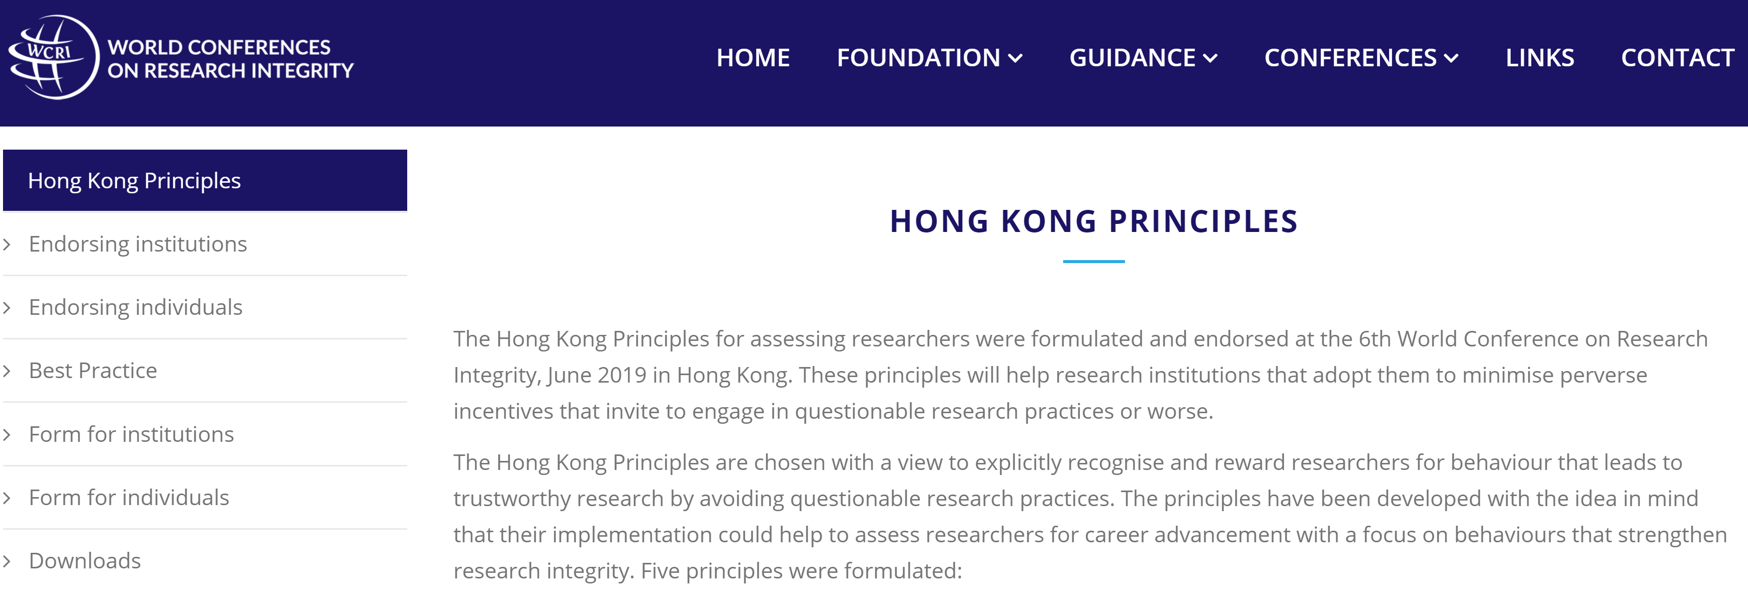
Please endorse the HKPs @
www.wcrif.org/guidance/hong-kong-principles
Notes:
This is the webpage of the HKPs. I’ll upload this presentation there as well.
Please endorse the HKPs, add best practice examples and use the materials we make available on this webpage.

Slide 16
core message
We should reward responsible research practices and avoid perverse incentives when assessing researchers and not merely rely on bibliometric indicators.
Notes:
Allow me to close with repeating my core message.

Slide 17


www.wcrif.org
www.wcri2022.org
Notes:
And please consider to join the 7th WCRI in Cape Town.
We had to postpone the 7th WCRI with a year but will offer a series of webinars on the days originally planed.
One of these webinars will focus on adapting the HKPs to LMICs.

